Slide 1
Emotion Classification
By Lin Tommy

Slide 2
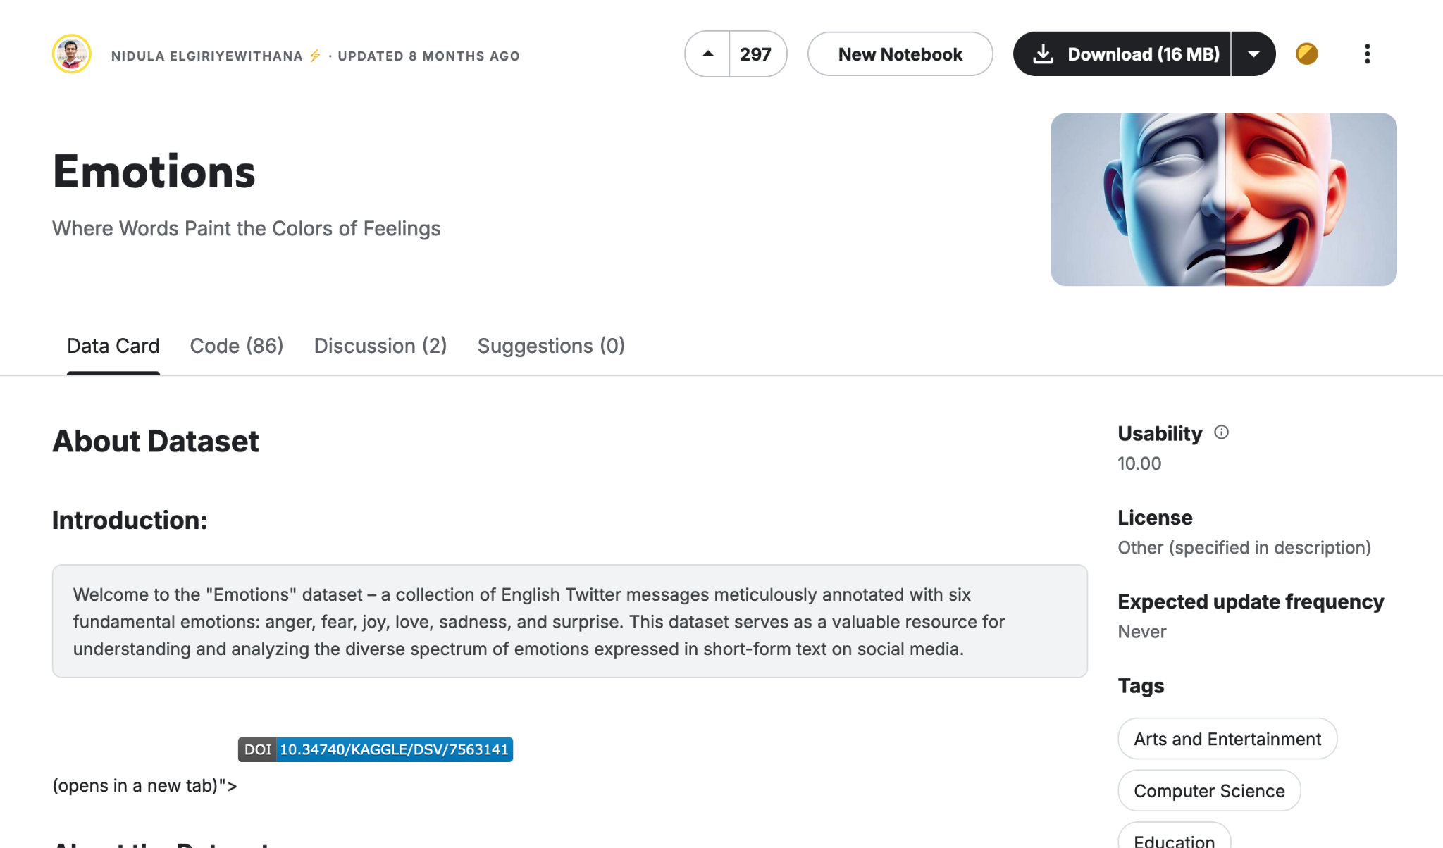
Dataset
https://www.kaggle.com/datasets/nelgiriyewithana/emotions

Slide 3
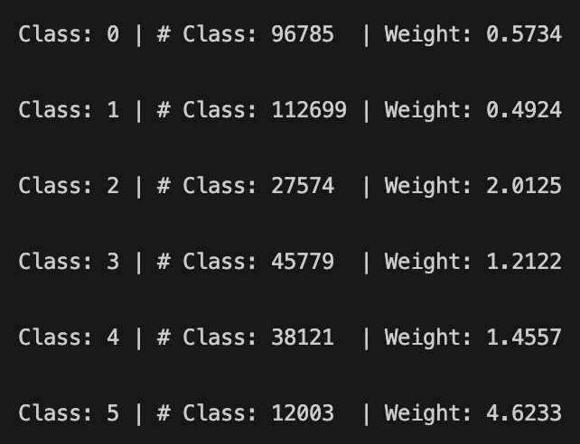
Preprocessing Data
Preparing Text
Remove punctuation, and 1-2 character words
Convert to lowercase
TF-IDF Approach:
Tokenizer
Stopword remover
Blank string remover
CountVectorizer
IDF transformer
Class Weights
Addressed class imbalance to improve model performance.
Enhances scalability and robustness as dataset size changes.

Slide 4

Models
Random Forest Classifier
Naive Bayes
Logistic Regression (BEST!)

Slide 5
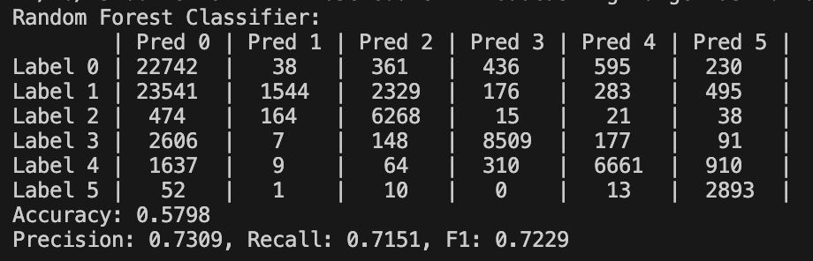
Random Forest Performance (Worst)

Slide 6
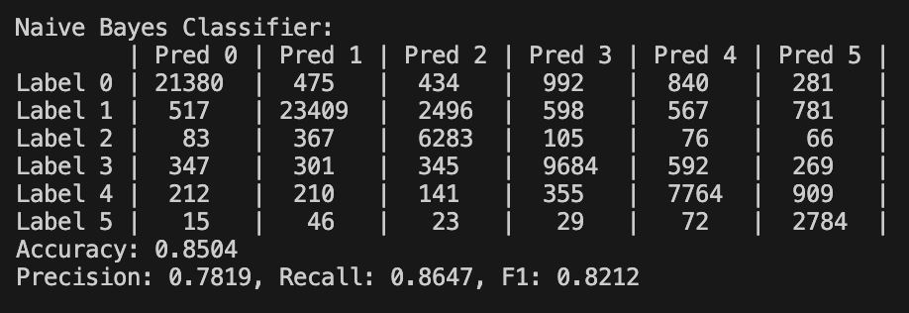
Naive Bayes Performance

Slide 7
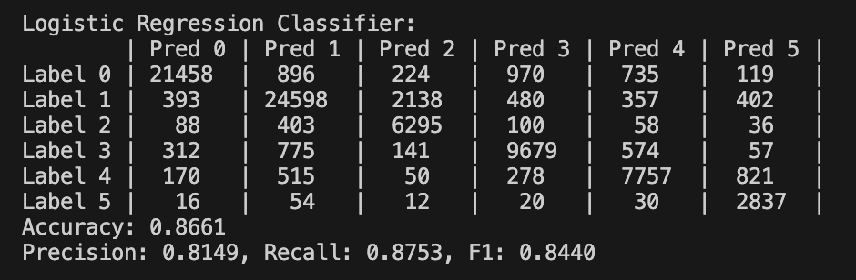
Logistic Regression Performance (Best)

Slide 8
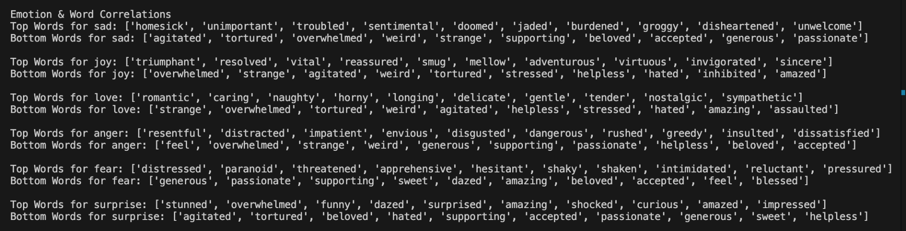
Word/Emotion Trends

Slide 9
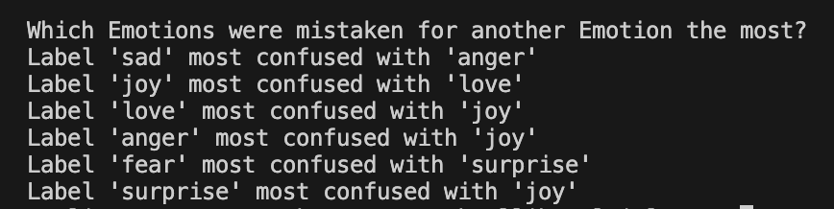
Examining Model Mistakes

